Slide 1
Computer Graphics
by
Dr. Metwally Rashad

Slide 2
Computer Graphics
Software
1/19

Slide 3
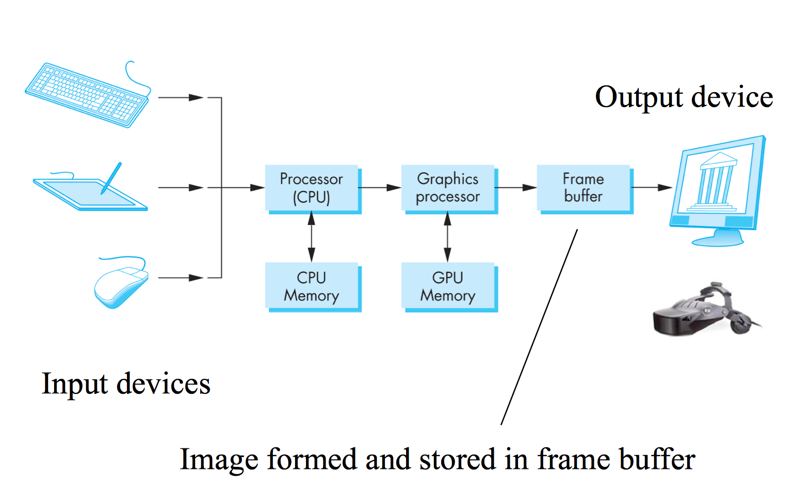
Overview of a graphics system
2/19

Slide 4
Computer Graphics Software
Special-purpose packages : are designed for nonprogrammers who want to generate pictures,
graphs, or charts in some application area without worrying about the graphics procedures that
might be needed to produce such displays.
- Set of menus that allow users to communicate with the programs in their own terms.
Example: architectural, business, medical, and engineering CAD systems.
General programming packages: are graphics library functions that can be used in a programming
language such as C, C++, Java, or Fortran.
- Basic functions in a typical graphics library include those for specifying picture components
(straight lines, polygons, spheres, and other objects), setting color values, selecting views of a
scene, and applying rotations or other transformations. Example: GL, OpenGL, Java 2D and
java 3D, and VRML.
- A set of graphics functions is often called a computer-graphics application programming
interface (CG API)
3/19

Slide 5
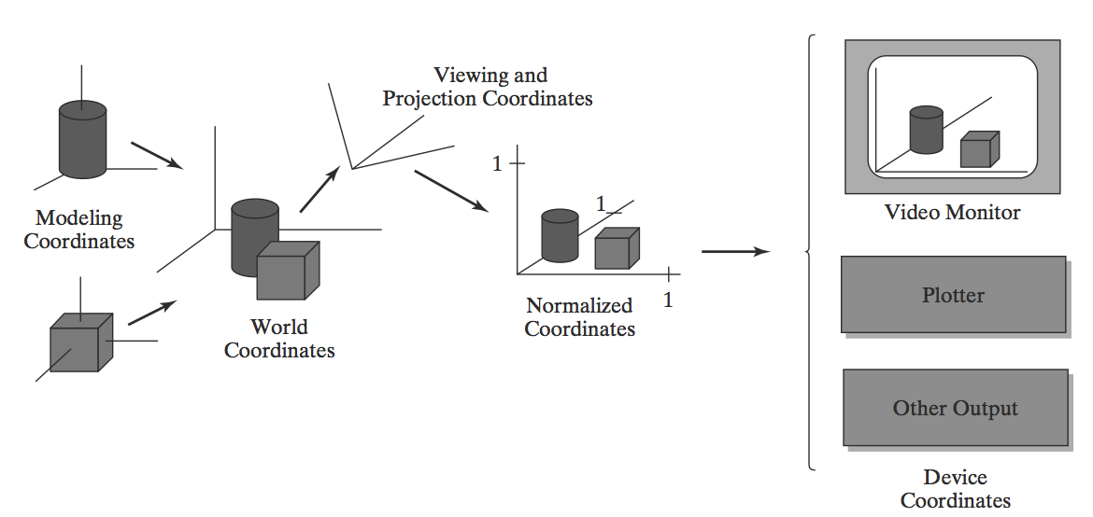
Coordinate Representations
To generate a picture using a programming package, we first need to give the geometric
descriptions of the objects that are to be displayed. These descriptions determine the
locations and shapes of the objects.
Coordinate transformations
from modeling coordinates
to device coordinates for a
display that is to contain a
view of two 3D objects.
4/19

Slide 6
Graphics Functions in graphics package
Attributes
[Color specifications, line styles, text styles, and
area-filling patterns]
Graphics output primitives
[Points, lines, filled color areas , shapes defined]
Input functions
View transformations
[View of scene and type of projection]
Geometric transformations
[Size, position, or orientation]
5/19

Slide 7
OpenGL library
OpenGL library is designed for efficient processing of 3D applications.
- Also can handle 2D scene descriptions as a special case of 3D where all the
z-coordinate values are 0.
• Open a window
• Get input from mouse and keyboard
• Menus
OpenGL Utility Toolkit
GLUT (start with “glut”)
• Buttons
• Checkboxes
• Radio buttons
GLUT-based user interface library
GLUI (start with “glui”)
OpenGL
Viewing and projection matrices
OpenGL Utility Library
GLU (start with “glu”)
Drawing
Graphics Library
GL (start with “gl”)
6/19

Slide 8
Basic OpenGL Syntax
Function names in the OpenGL basic library are prefixed with gl, and each component word within a function name has its first letter capitalized.
Ex.
glBegin, glClear, glCopyPixels, glPolygonMode
Functions require that one (or more) of their arguments be assigned a symbolic constant specifying, for instance, a parameter name, a value for a parameter, or a particular mode. All such constants begin with the uppercase letters GL, a constant name are written in capital letters, and the underscore (_) is used as a separator between all component words in the name.
Ex.
GL_2D, GL_RGB, GL_CCW, GL_POLYGON, GL_AMBIENT_AND_DIFFUSE
7/19

Slide 9
Basic OpenGL Syntax
The OpenGL functions also expect specific data types, OpenGL uses special built-in, data-type names.
Each data-type name begins with the capital letters GL, and the remainder of the name is a standard data-type designation written in lowercase letters.
Ex.
GLbyte, GLshort, GLint, GLfloat, GLdouble, Glboolean
To create a graphics display using OpenGL, we first need to set up a display window on our video screen. This is simply the rectangular area of the screen in which our picture will be displayed.
8/19

Slide 10
Basic OpenGL Syntax
The basic OpenGL functions since this library contains only device independent graphics functions, and window-management operations depend on the computer, we are using.
- OpenGL Extension to the X Window System (GLX)
- Apple systems can use the Apple GL (AGL)
- MicrosoftWindows systems can use the (WGL)
The OpenGL Utility Toolkit (GLUT) provides a library of functions for interacting with any screen-windowing system.
9/19

Slide 11
Basic OpenGL Syntax
Header Files
In graphics programs, we will need to include the header file for the OpenGL core library.
For most applications we will also need GLU, and on many systems we will need to include the header file for the window system.
Source file in this case would begin with:
#include <windows.h> C++ H.F. #include <stdio.h>
#include <GL/gl.h> #include <GL/glut.h> #include <stdlib.h>
#include <GL/glu.h> #include <math.h>
10/19

Slide 12
Basic OpenGL Syntax
Display-Window Management Using GLUT
First step is to initialize GLUT.
glutInit (&argc, argv);
A display window is to be created on the screen with a given caption for the title bar.
glutCreateWindow ("An Example OpenGL Program");
- But the display window is not yet on the screen. We need one more GLUT function
to complete the window-processing operations.
glutMainLoop ( );
This function must be the last one in our program
11/19

Slide 13
Basic OpenGL Syntax
- Specify what the display window is to contain. For this, we create a picture using
OpenGL functions and pass the picture definition to the GLUT routine glutDisplayFunc
glutDisplayFunc (lineSegment);
- Display window have some default location and size, we can set these parameters
using additional GLUT functions.
- We use glutInitWindowPosition function to give an initial location for the upperleft
corner of the display window.
12/19

Slide 14
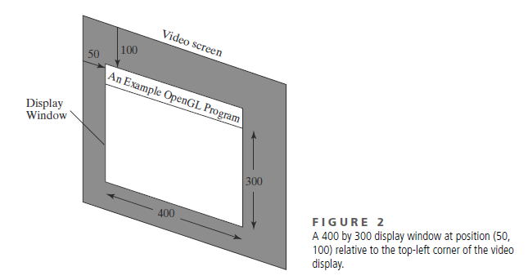
Basic OpenGL Syntax
- Similarly, the glutInitWindowSize function is used to set the initial pixel width and
height of the display window.
glutInitWindowPosition (50, 100);
glutInitWindowSize (400, 300);
- After the display window is on
the screen, we can reposition
and resize it.
13/19

Slide 15
Basic OpenGL Syntax
- We can also set a number of other options for the display window, such as buffering and
a choice of color modes, with the glutInitDisplayMode function.
glutInitDisplayMode (GLUT_SINGLE | GLUT_RGB);
GLUT_SINGLE: a single refresh buffer is to be used for the display window
GLUT_RGB : use the color mode which uses red, green, and blue (RGB) components to
select color values:
- We can choose a background color (white) for display windows using OpenGL function
glClearColor (1.0, 1.0, 1.0, 0.0);
14/19

Slide 16
Basic OpenGL Syntax
- To get the assigned window color displayed
glClear (GL_COLOR_BUFFER_BIT);
GL_COLOR_BUFFER_BIT : is an OpenGL symbolic constant specifying that it is the bit
values in the color buffer .
- We can make color for the objects we want to display in a scene, set the object color
to be a dark green:
glColor3f (0.0, 0.4, 0.2); 3f: are RGB color components using floating-point
(f) values
15/19

Slide 17
Basic OpenGL Syntax
- We simply display a 2D line segment. To do this, we need to tell OpenGL how we
want to “project” our picture onto the display window because generating a 2D
picture is treated by OpenGL as a special case of 3D viewing.
glMatrixMode (GL_PROJECTION);
gluOrtho2D (0.0, 200.0, 0.0, 150.0);
x-coordinate values within this rectangle range from 0.0 to 200.0 with y-coordinate
values ranging from 0.0 to 150.0
16/19

Slide 18
Basic OpenGL Syntax
- The following code defines a 2D straight line segment with integer, Cartesian
endpoint coordinates (180, 15) and (10, 145).
glBegin (GL_LINES);
glVertex2i (180, 15);
glVertex2i (10, 145);
glEnd ( );
17/19

Slide 19
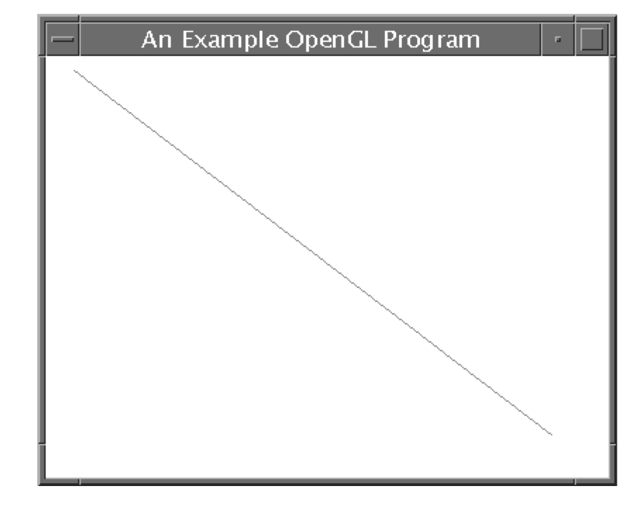
Basic OpenGL Syntax
- Write OpenGL program to display this figure.
The following OpenGL program is organized into
three functions:
1. init,
- place all initializations and related one-time
parameter settings in this function.
2. lineSegment,
- geometric description of the “picture” that
we want to display is in this function.
3. main function
- contains the GLUT functions for setting up the
display window and getting our line segment onto the screen.
18/19

Slide 20
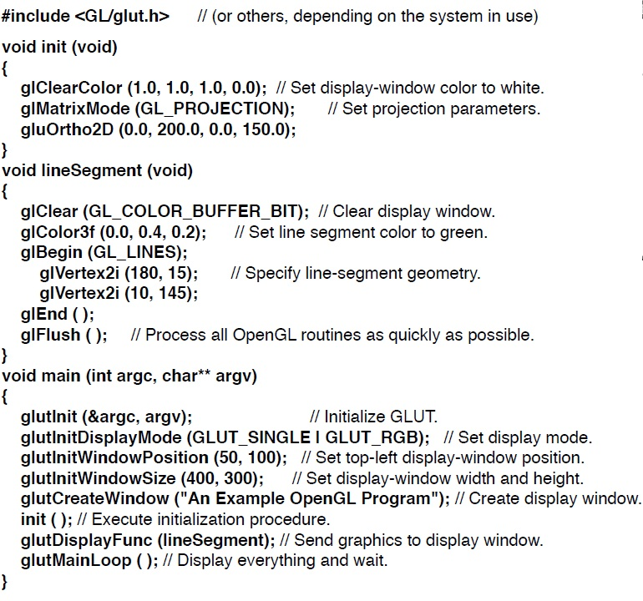
2/20

